Slide 1


Slide 2




Slide 3


Slide 4
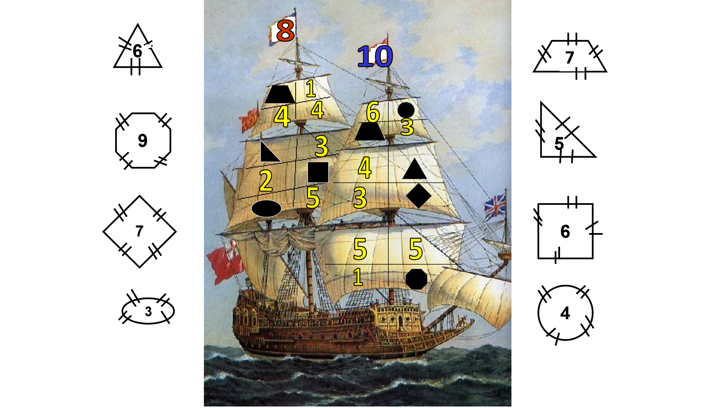

Slide 5


Slide 6


7-3= 5-4=
9-3= 6-2=
8-4= 6-1=
4
1
6
4
4
5

Slide 7

5+5-6+2-3 +1=
9-6+2+5-2-1=
2+1+5-4-2+6=
4
7
8

